Slide 1
Gesture Controlled Vehicle
TEAM B
Rubyet Kamal
Yuming Wang
Moiz Malik

Slide 2
Equipment Used
Diligent Bluetooth Pmod
Acceleration meter inside FPGA
ESP32

Slide 3
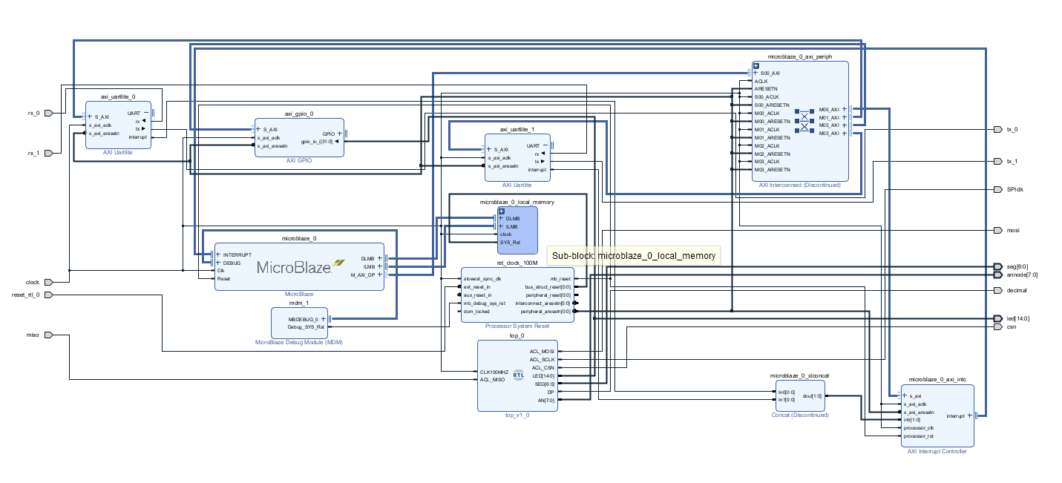
IP Block Diagram

Slide 4
Function Target
Moving FPGA will lead to acceleration/deacceleration of the vehicle.

